Slide 1
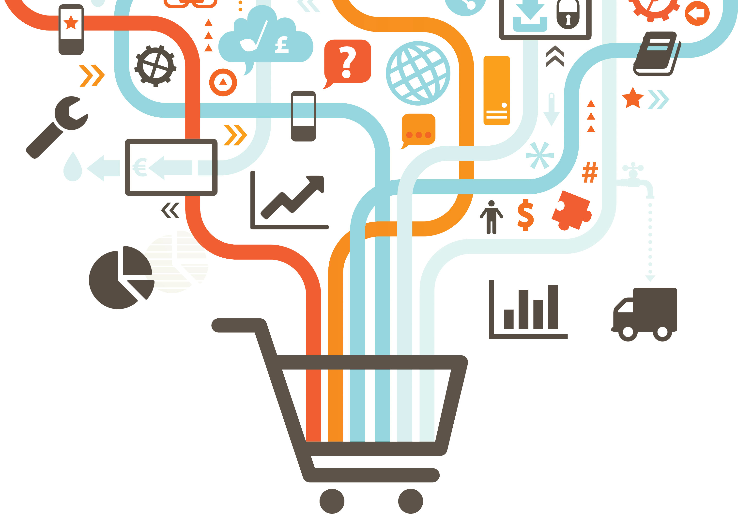
Marketing Ch. 4 Review

Slide 2
What is the difference between direct and indirect distribution?
Direct distribution – producers sell directly to consumers
Indirect distribution – involves other businesses

Slide 3
What are the major factors to be considered when a business selects a channel of distribution?
Perishability
Distance
Special Handling
Number of Customers

Slide 4
What are some ways a manufacturer can use to insure the effectiveness of an indirect channel of distribution?
Careful selection of channel members
Regularly communicating with channel members
Providing customer information to help planning.

Slide 5
Why are the needs and preferences of consumers so important in planning distribution?
If the channel doesn’t meet the consumer needs regarding:
Location
Timing
Quality
Price
the consumer will not make a purchase.

Slide 6
What are some ways that computers are used to improve distribution?
Taking and processing orders
Tracking shipments
Handling customer service problems

Slide 7
Give an example of a wholesaler and retailer.
Wholesaler
Companies that assist with distribution activities between business.
Seldom sell products to individual consumers.
Olean Wholesale, BJ’s, Sam’s Club
Retailer
The final business organization in an indirect channel of distribution for consumer products
They accumulate the products their consumer needs by buying from manufacturers and wholesalers.
Walmart, Shop and Save, Hanson Farms

Slide 8
What benefits do wholesalers provide to small retailers?
Provide specialized activities
Are more efficient
Good information sources
May be able to provide the latest technology

Slide 9
What are the 4 types of retail businesses
Single, limited-line stores
Mixed merchandise stores
Super stores
Non-store retailing

Slide 10
Why must all marketing functions be performed by some member of a channel of distribution?
Each function must be completed for a satisfying exchange to take place.
Without each function, either the exchange cannot occur or someone will not be satisfied.

Slide 11
Why would a large retailer want to use a wholesaler?
A wholesaler could help with obtaining merchandise from
small manufacturers,
businesses in other countries,
or for specialty items that do not have a high sales volume.

Slide 12
Why is it possible for an indirect channel of distribution that includes a wholesaler and retailers to be more efficient than a direct channel?
Specialized channel members can be more efficient or handle products more quickly and with less damage, thus reducing the cost of distribution.

Slide 13
Why is non-store retailing popular with so many consumers?
It is often more convenient to order online, through catalogs or from visiting salespeople.

Slide 14
What is the difference between exporting and importing?
Exporting – selling to other countries
Importing – buying from other countries

Slide 15
Name the 7 Marketing Functions to be performed in conducting international business.
Product/Service Management
Distribution
Selling
Marketing Information Management
Financing
Pricing
Promotion

Slide 16
Why do many companies fail to consider international marketing when selecting target markets?
If businesspeople don’t have international experience they may think international marketing is too difficult and expensive.

Slide 17
What are the possible disadvantages of participating in a joint venture with a business from another country?
It requires the cooperation of the other company in decision making.
If one of the businesses decides to get out of the venture, it may be difficult for the other business to continue.

Slide 18
Why is managing marketing information such an important function when marketing in another country?
There will be different sources of information it may be more difficult to collect.
Information may need to be communicated in more than one language.

Slide 19
What is a non-store retailer? Give 2 Examples.
A non-store retailer sells directly to the consumer’s home rather than requiring the consumer to travel to a store.
Examples
Door to Door Selling
Online Sales
Vending Machines
At Home Parties
Telephone Sales
Tv Shopping Clubs
Direct Mail Selling

Slide 20
What discrepancies between producers and consumers are reduced with effective distribution?
Discrepancies in variety and quantities of products produced and consumed.
Discrepancies in the time and location of production and consumption.

Slide 21
What two common type of businesses are involved in indirect distribution but not direct distribution?
Wholesalers
Retailers

Slide 22
In what ways can wholesalers benefit manufacturers and retailers?
Providing specialized marketing functions and working with small businesses.

Slide 23
Approximately what percent of US businesses buy and sell products in other countries.
10 percent

Slide 24
What are the challenges involved in distributing products internationally?
Transportation
Differences in language and currencies
Laws
Customs

Slide 25
Why do many Internet businesses use indirect channels of distribution even though they have direct contact with customers?
They still may need help transporting and storing products or providing customer service since most of the business customers will be located in other cities and countries.

Slide 26
What are some examples of products where perishability and special handling are important distribution concerns?
Medicine
Flowers
Fresh food
Very expensive items
Antiques
Jewelry

Slide 27
How can having a wholesaler as part of a channel of distribution benefit consumers?
The wholesaler may be concerned about the specific needs of unique or smaller target markets.
They may have specialized equipment and expertise in performing some of the marketing functions.

Slide 28
What advantages do super stores provide for consumers?
A large quantity and variety of merchandise in one location.
Lower product pricing

Slide 29
What disadvantages do superstores provide to consumers?
Lower levels of service
Fewer specialized products
Longer shopping time

Slide 30
What characteristics should a company look for when selecting an exporter to help develop international business?
An exporter who is very familiar with and experienced in the countries and with the markets the business wants to serve.
One who has the specialized expertise in marketing functions the business needs to have performed.

Slide 31
How can technology affect each of the marketing mix elements for a company involved in international marketing?
Product
the country must have the technology to use the product.
Price
the technology may differ among different countries
Place
technologies for transporting and storage and tracking shipments using barcode technology.
Promotion
a country may have unique laws or procedures for using media. Internet access may be restricted for communicating with customers.

